Slide 1
Natural Language Processing and Information Extraction
2025 WS
Gábor Recski
Florina Piroi
Varvara Arzt
Allan Hanbury

Slide 2
Contents
Course information
Introduction to NLP

Slide 3
Course information

Slide 4


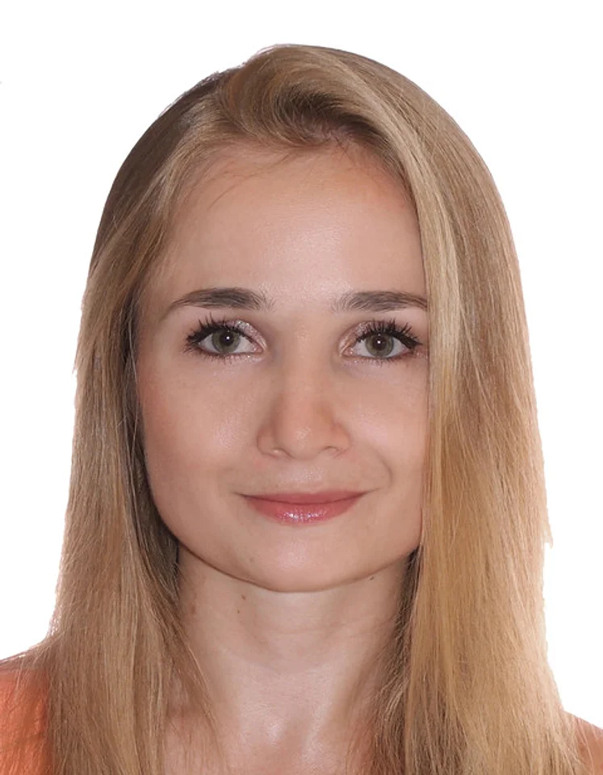

Lecturers
Gábor Recski
Florina Piroi
Varvara Arzt
Allan Hanbury

Slide 5
Lecture Schedule
Course Information, Introduction to NLP [Hanbury] (3.10.2025)
Text Processing [Recski] (10.10.2025)
Text Classification [Recski] (17.10.2025)
Deep Learning for NLP I [Piroi] (24.10.2025)
Deep Learning for NLP II [Piroi] (31.10.2025)
Deep Learning – Practical Lesson [Arzt] (7.11.2025)
Syntax [Recski] (14.11.2025)
Semantics [Recski] (21.11.2025)
Information Extraction [Recski] (28.11.2025)
Retrieval-augmented Generation [Recski] (5.12.2025)
Summarisation & Keyword Extraction [Piroi] (19.12.2025)
Annotation Basics and Challenges [Hanbury] (9.1.2026)
Project Presentations (16.1.2026)

Slide 6
Lectures
Fridays 14:00 c.t. - 16:00
EI11

Slide 7
Exercise
One project exercise with two Milestones
Done in groups of four
Each group has a mentor
Submissions are made via GitHub
Grading is based on milestones, final submission, presentation, and report
Every group member must present their own contributions in the final presentation and will be individually evaluated on these contributions
Detailed schedule and discussion at the end of the lecture today
Note that topic selection is due by the end of next week

Slide 8
Exercise Deadlines
Oct 6: Project introduced
Oct 13: Project milestone 1 introduced
Oct 20: Topics assigned, Project milestone 2 introduced
Nov 3: Milestone 1 deadline
Dec 1: Milestone 2 deadline
Dec 15: Review meetings 9-13
Jan 19: Project presentation deadline
Jan 28: Project final submission deadline

Slide 9
Effort Breakdown
Lectures: 24 hours
Project Milestone 1: 8 hours
Project Milestone 2: 8 hours
Final Solution: 35 hours
Total: 75 hours

Slide 10
Performance Evaluation
Milestone 1: Minimum 35%
Milestone 2: Minimum 35%
Final solution: Minimum 35%
Overall Score: Minimum 50% to pass
15% for Milestone 1
15% for Milestone 2
50% for the final solution
10% for the presentation
10% for the management summary
There is no exam!
Marks Overall Score
1 89 – 100
2 76 – 88
3 63 – 75
4 50 – 62

Slide 11
Organisation
Course
Please register for the course in TISS
Communication
Use the General Discussion Forum in TUWEL for questions, not the TISS forum
The schedule of lectures and all course material will be available on Github

Slide 12
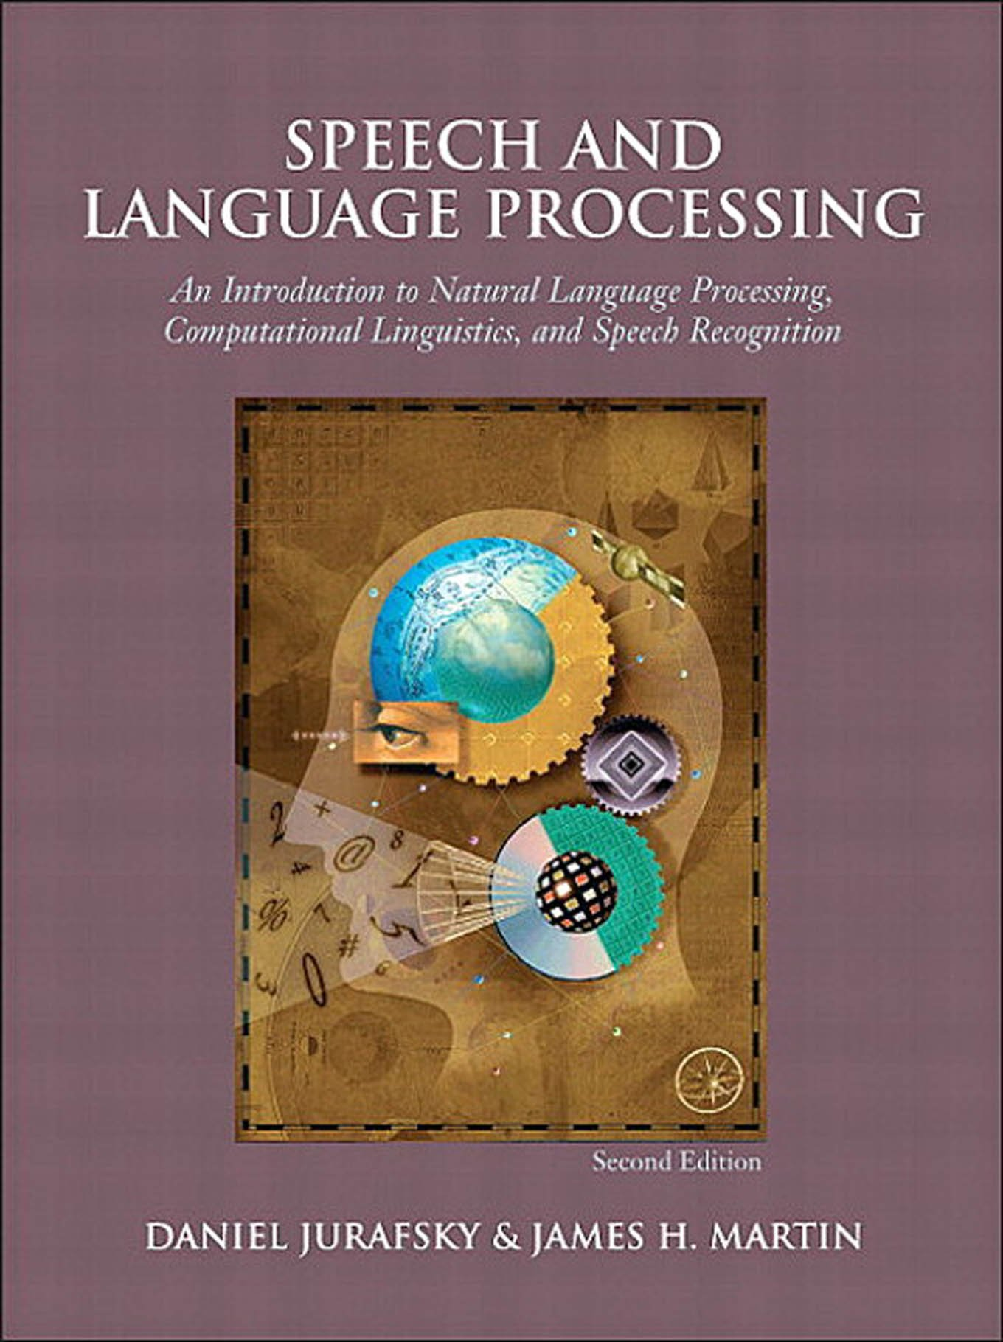
Book
Third edition in preparation – download many chapters here:
https://web.stanford.edu/~jurafsky/slp3/

Slide 13
Questions about the organisation, etc.
Ask now!

Slide 14
Introduction to NLP

Slide 15
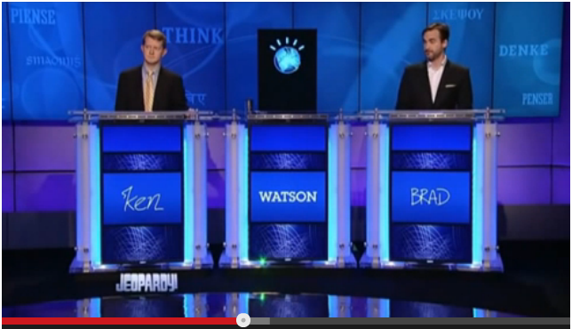
IBM Watson and Jeopardy
Final question: https://www.youtube.com/watch?v=Sp4q60BsHoY
IBM film: https://www.youtube.com/watch?v=P18EdAKuC1U

Slide 16
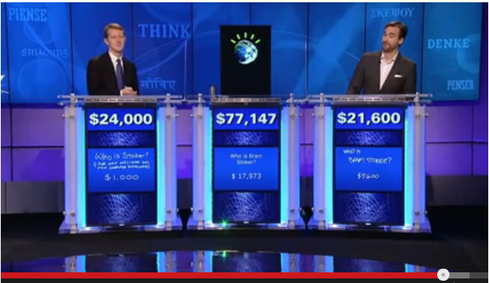
The end of the show

Slide 17
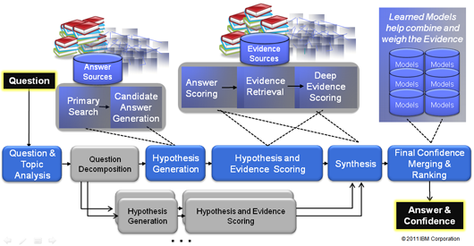
How does Watson (for Jeopardy) work?

Slide 18
How does Watson (for Jeopardy) work?
Information Retrieval
Machine Learning
Knowledge Representation and Reasoning
Natural Language Processing
Parallel and Distributed Computing

Slide 19

https://www.ibm.com/watson-health/oncology-and-genomics

Slide 20


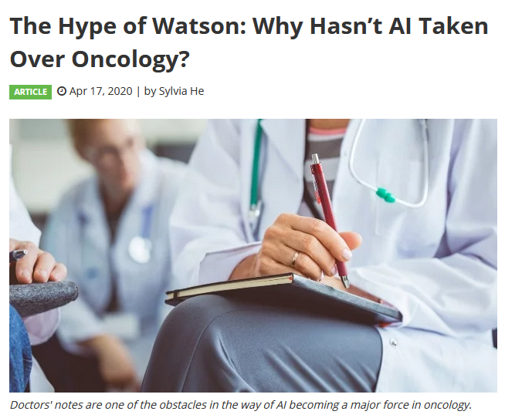
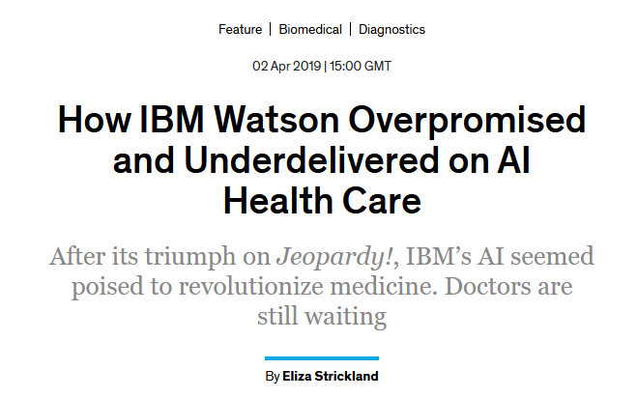
https://spectrum.ieee.org/biomedical/diagnostics/how-ibm-watson-overpromised-and-underdelivered-on-ai-health-care
https://www.technologynetworks.com/informatics/articles/the-hype-of-watson-why-hasnt-ai-taken-over-oncology-333571

Slide 21
Natural Language Processing (NLP)
Natural language processing (NLP) is a subfield of linguistics, computer science, and artificial intelligence concerned with the interactions between computers and human language, in particular how to program computers to process and analyze large amounts of natural language data.
wikipedia

Slide 22
Why is NLP interesting?
Languages involve many human activities
Reading, writing, speaking, listening
Voice can be used as a user interface in many applications
Remote controls, virtual assistants like siri,...
NLP is used to acquire insights from massive amount of textual data
E.g., hypotheses from medical & health reports
NLP has many applications
NLP is difficult!
https://www.slideshare.net/minhpqn/introduction-to-natural-language-processing-67212472

Slide 23
Why is NLP difficult?
I made her duck
I cooked waterfowl for her.
I cooked waterfowl belonging to her.
I created the (plaster?) duck she owns.
I caused her to quickly lower her head or body.
I waved my magic wand and turned her into undifferentiated waterfowl.
Jurafsky & Martin Book
Notes:
Ambiguity

Slide 24
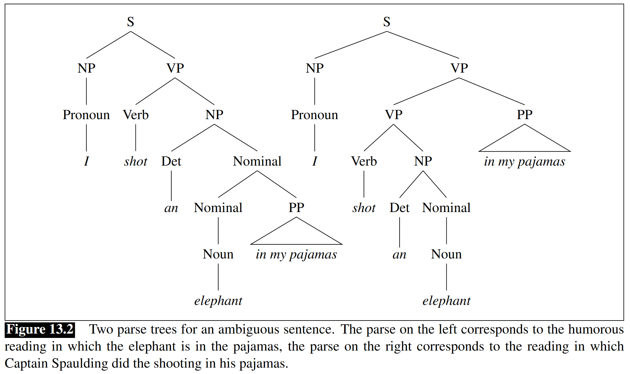

I shot an elephant in my pyjamas.
https://freesvg.org/elephant-in-pajamas
Jurafsky & Martin Book
Notes:
Groucho Marx’s well-known line as Captain Spaulding in Animal Crackers.

Slide 25
Why is NLP difficult?
Natural Languages are generally ambiguous
Various levels of knowledge of a language must be considered:
Phonetics and Phonology — knowledge about linguistic sounds
Morphology — knowledge of the meaningful components of words
I am → I’m, forms for singular and plural (door/doors)
Syntax — knowledge of the structural relationships between words, needed to order and group words (grammatical rules)
Semantics — knowledge of meaning
What is meant by “export” and “expert”? What constitutes “Western Europe”?
Pragmatics — knowledge of the relationship of meaning to the goals and intentions of the speaker
Is it a request, question or a statement?
Discourse — knowledge about linguistic units larger than a single utterance
Reference to the context given by e.g. multiple sentences.
E.g. In what year was Lincoln born? How many states were in the United States in that year?

Slide 26
Very Brief History of NLP
Foundational Insights: 1940s and 1950s
Generally two paradigms:
Symbolic Paradigm
Stochastic Paradigm
The Rise of Machine Learning: 2000-now
Large amount of spoken and textual data become available
Widespread availability of high-performance computing systems
The Domination of Neural Approaches: ~2015-now

Slide 27
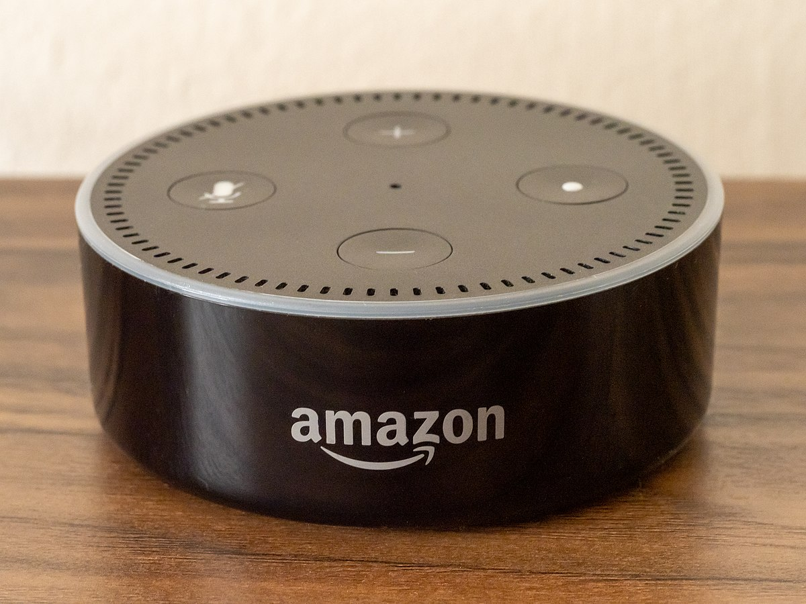

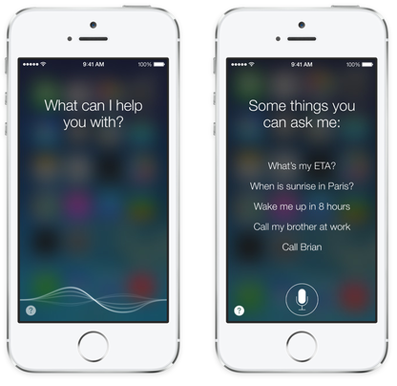
Dialogue systems
https://upload.wikimedia.org/wikipedia/commons/4/44/IOS_7_Siri.png
https://commons.wikimedia.org/wiki/File:Cortana_start_screen_(yellow-white).png
https://commons.wikimedia.org/wiki/File:Amazon_Alexa_-_Echo_Dot_(49675526278).jpg

Slide 28
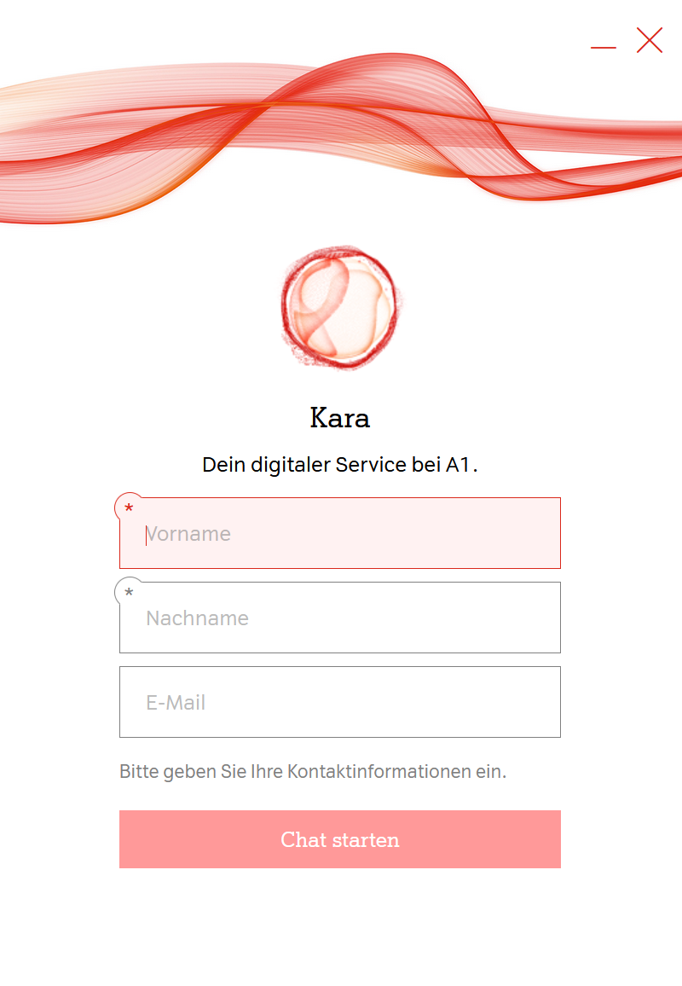
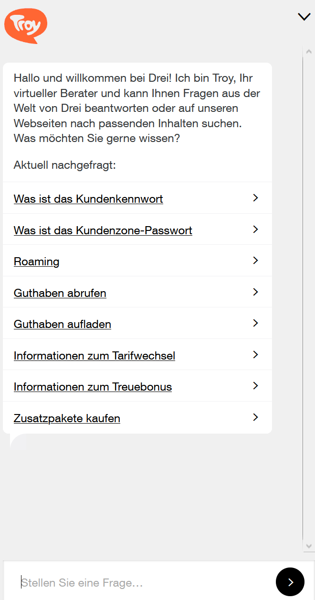
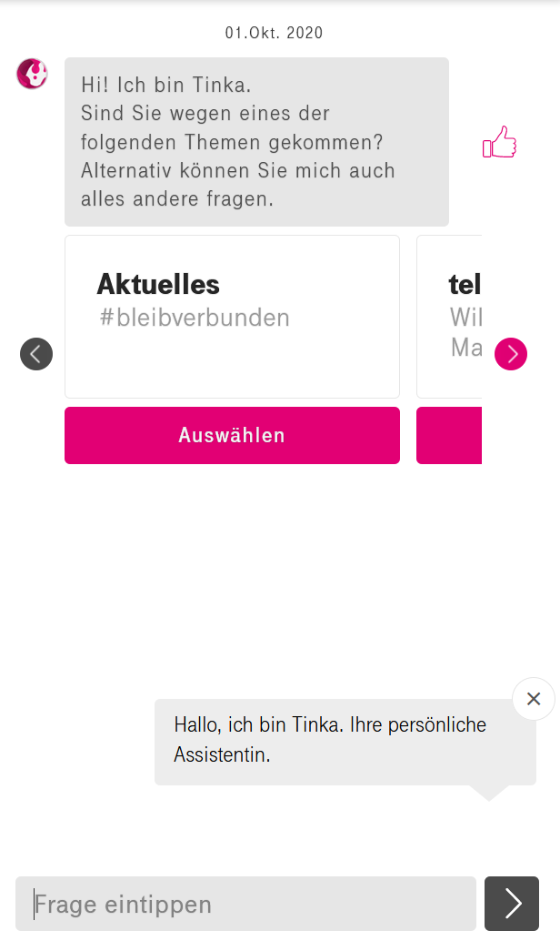

Slide 29
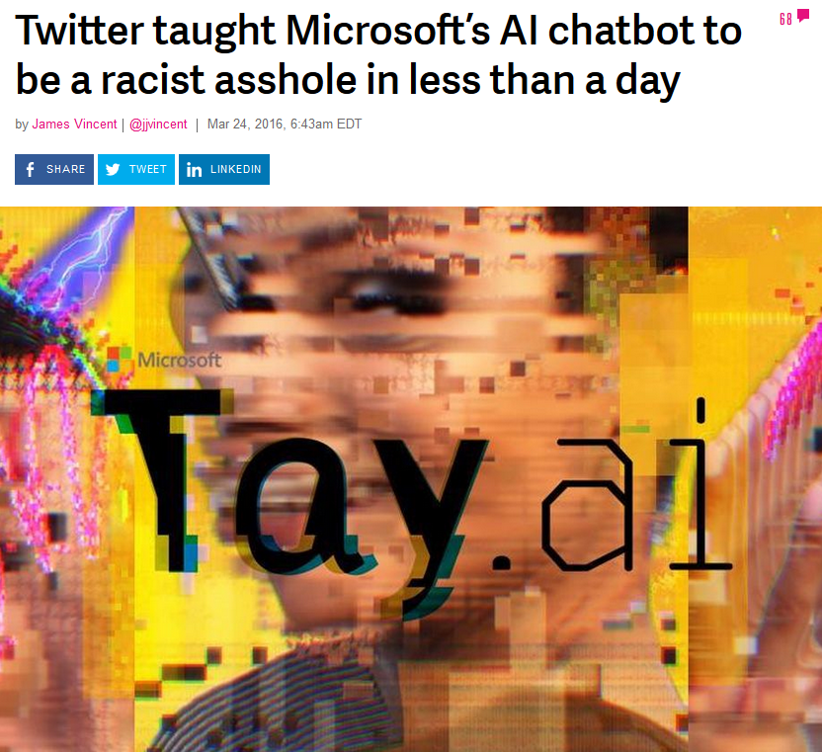
Training Data Bias…
https://www.theverge.com/2016/3/24/11297050/tay-microsoft-chatbot-racist

Slide 30
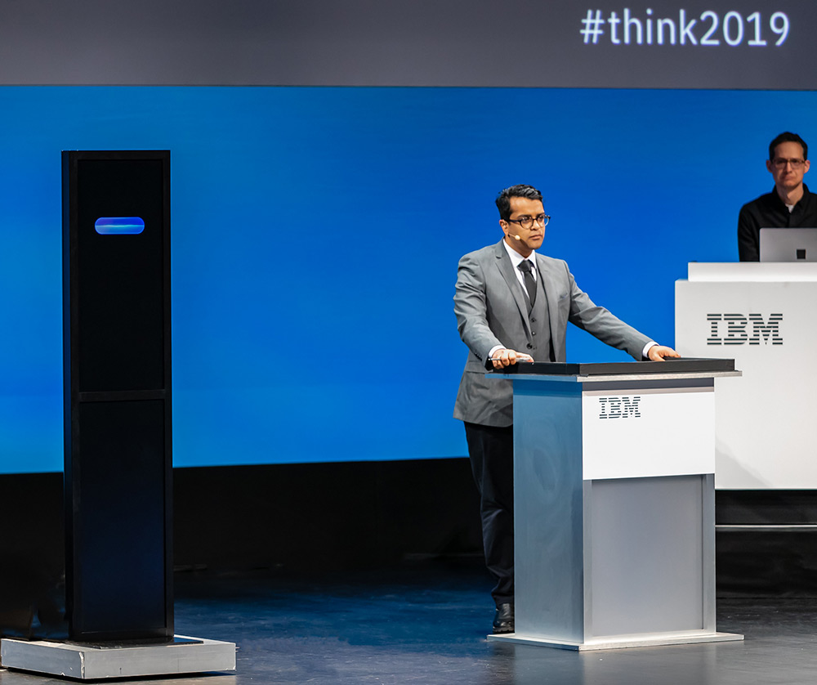
Project Debater
Highlights: https://www.youtube.com/watch?v=nJXcFtY9cWY
Full debate: https://www.youtube.com/watch?v=-d4Uj9ViP9o
https://www.research.ibm.com/artificial-intelligence/project-debater/live/images/leadspace-livedebate.jpg

Slide 31


Slide 32
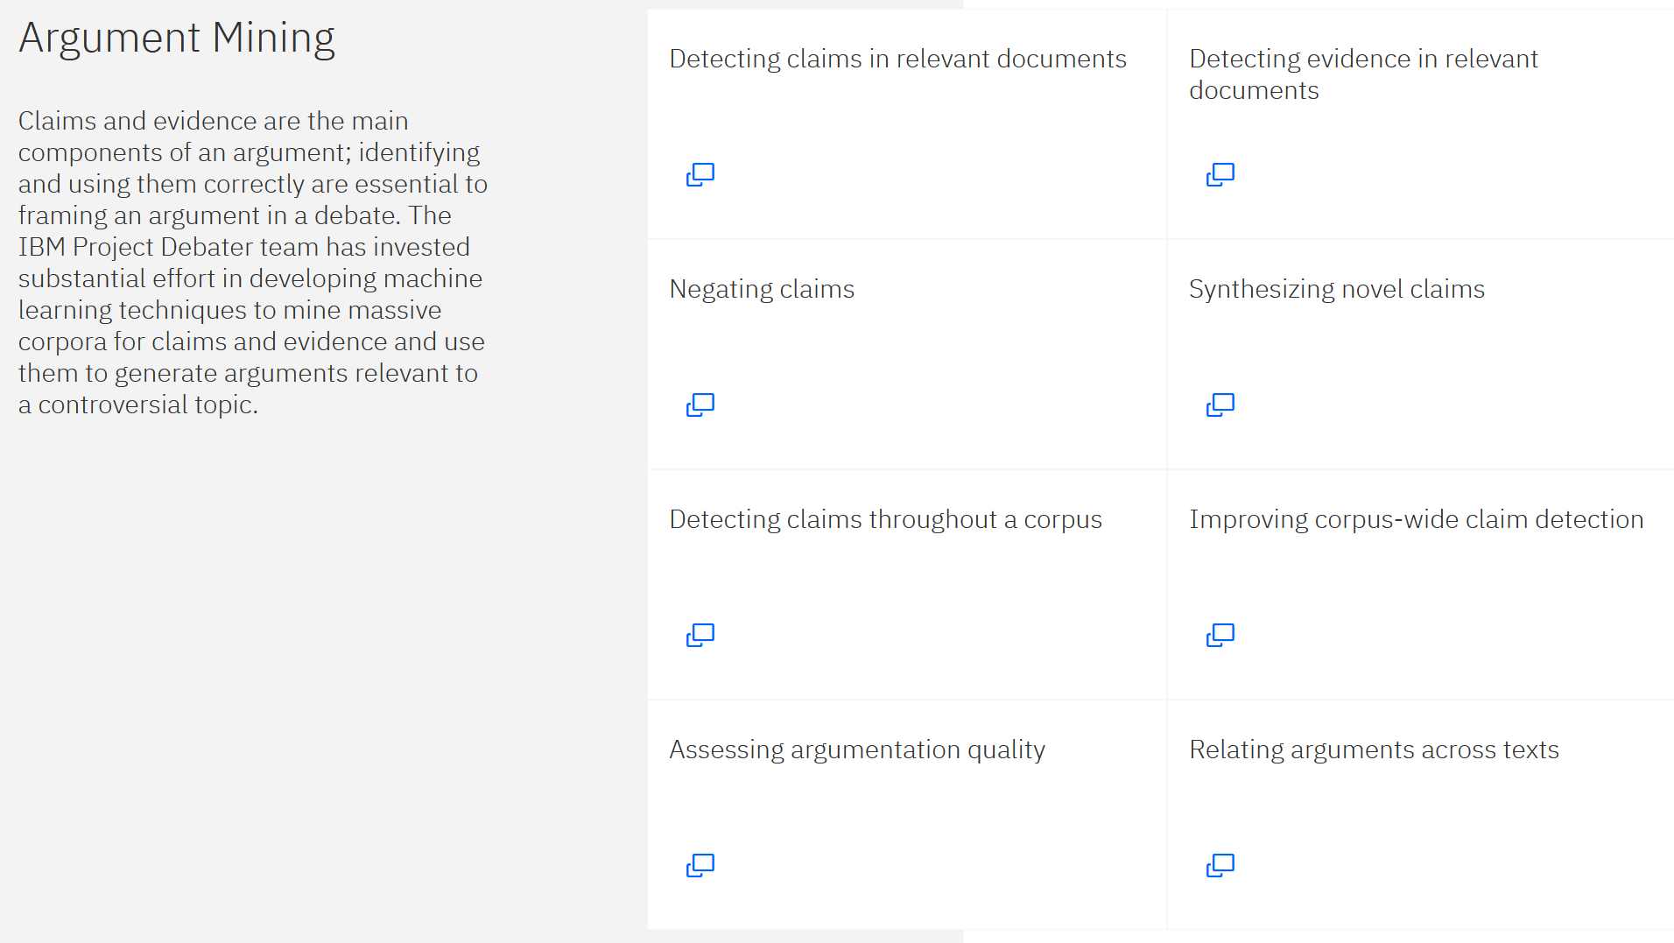
https://www.research.ibm.com/artificial-intelligence/project-debater/how-it-works/

Slide 33
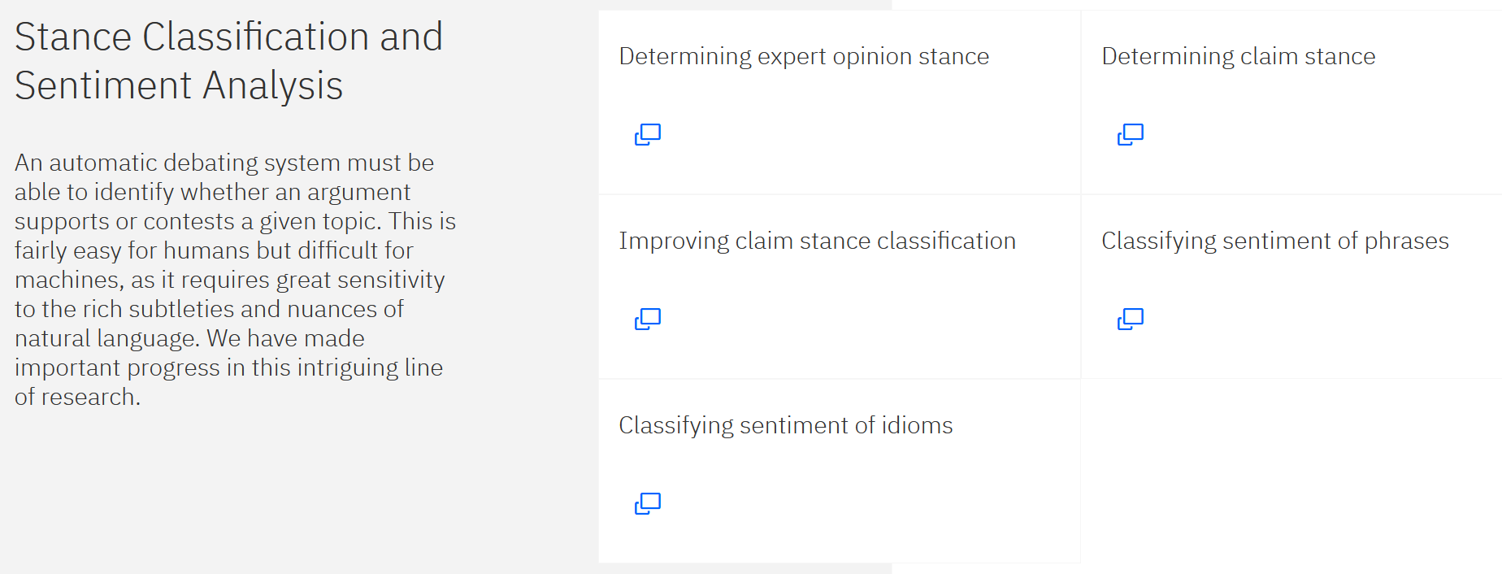
https://www.research.ibm.com/artificial-intelligence/project-debater/how-it-works/

Slide 34
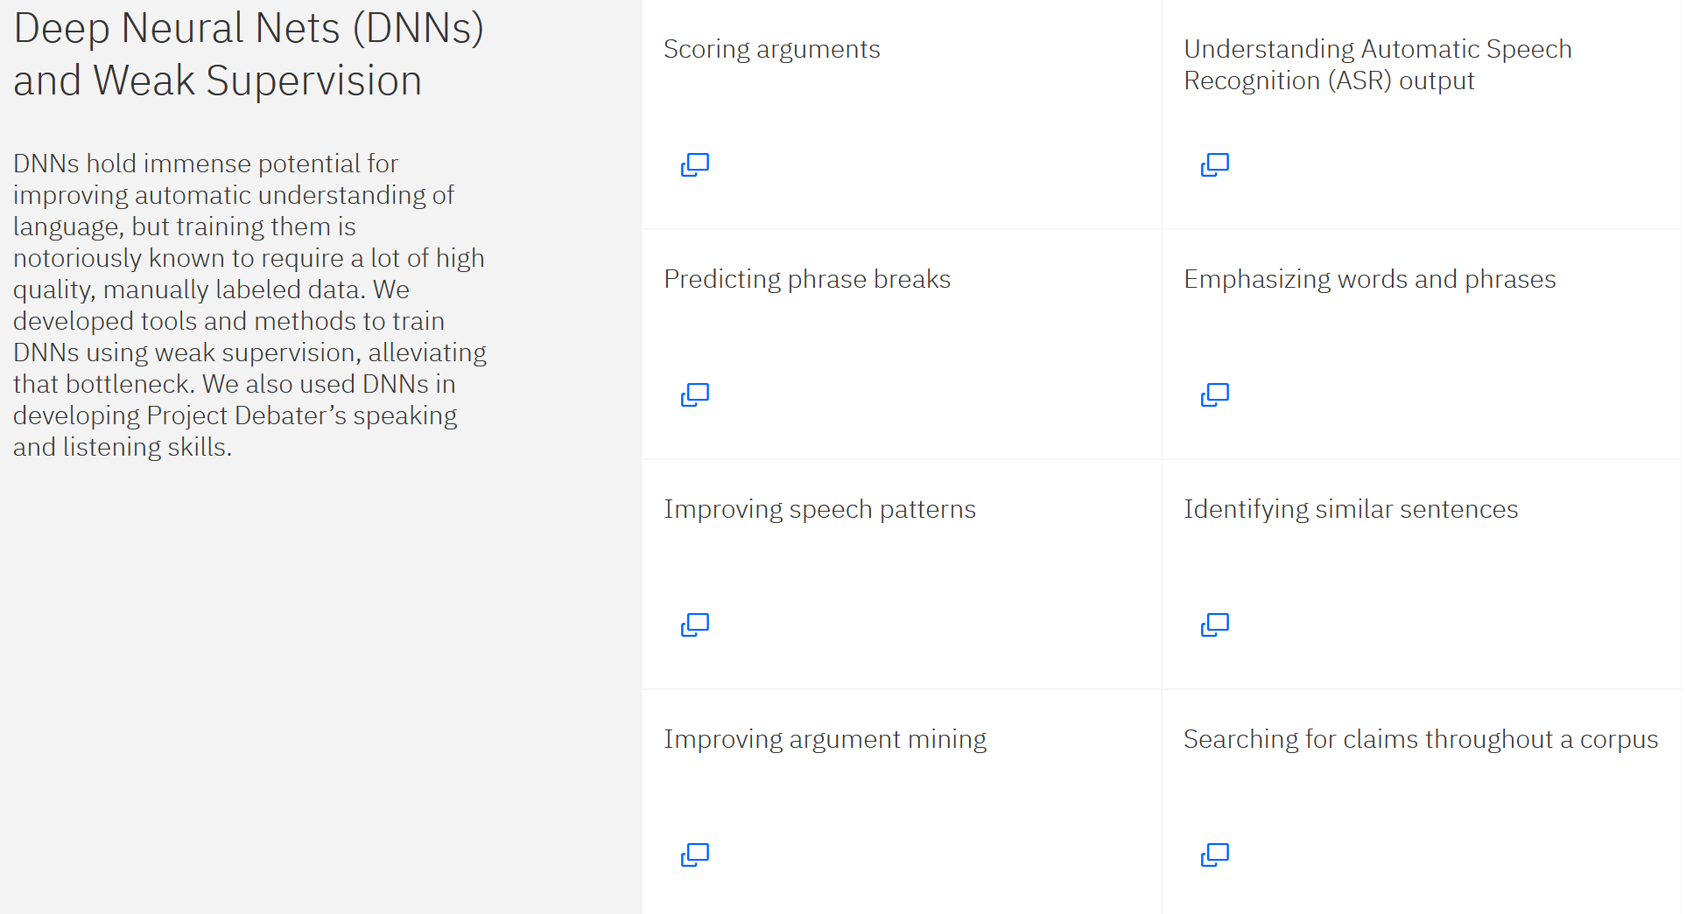
https://www.research.ibm.com/artificial-intelligence/project-debater/how-it-works/

Slide 35
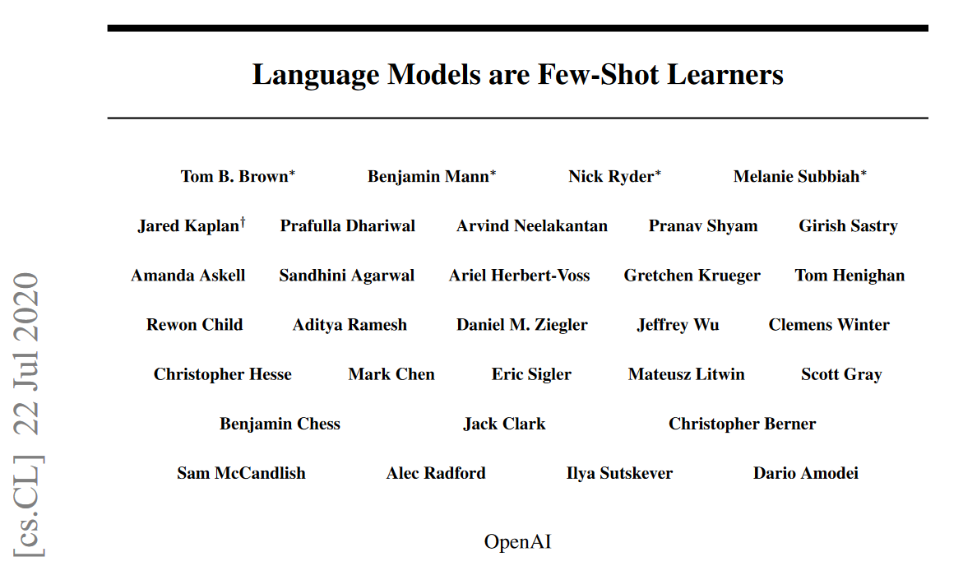
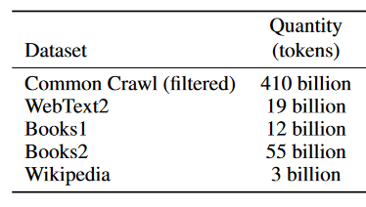
GPT-3
Large Language Model (LLM) with 175 billion parameters
Training datasets
https://arxiv.org/abs/2005.14165
Notes:
A statistical language model is a probability distribution over sequences of words. Given such a sequence, say of length m, it assigns a probability P ( w 1 , … , w m ) {\displaystyle P(w_{1},\ldots ,w_{m})} P(w_{1},\ldots ,w_{m}) to the whole sequence.

Slide 36
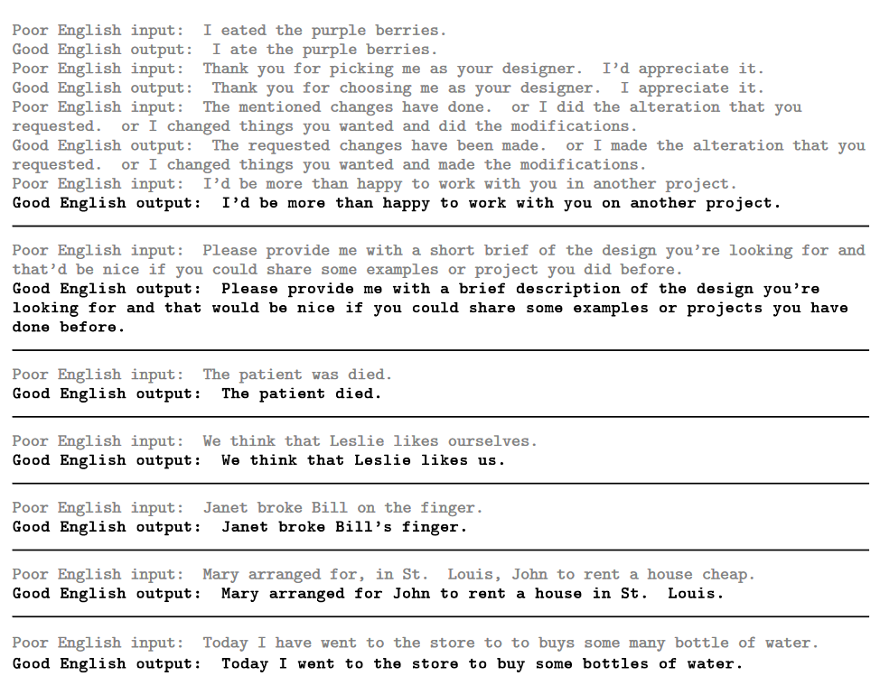
Correcting English
Notes:
Brief training for correcting English

Slide 37
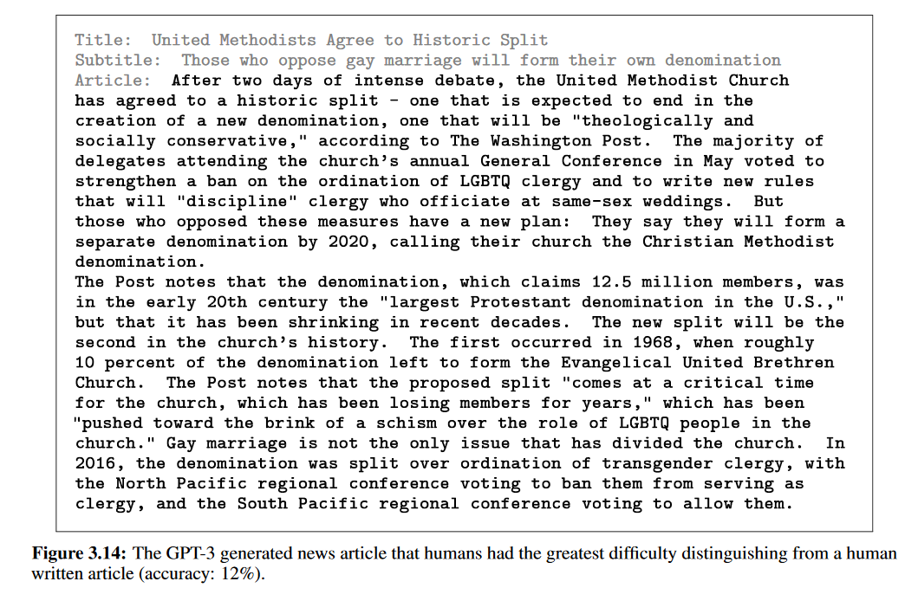
News Article Generation
Notes:
Gave three news articles as examples before providing the title and subtitle.

Slide 38
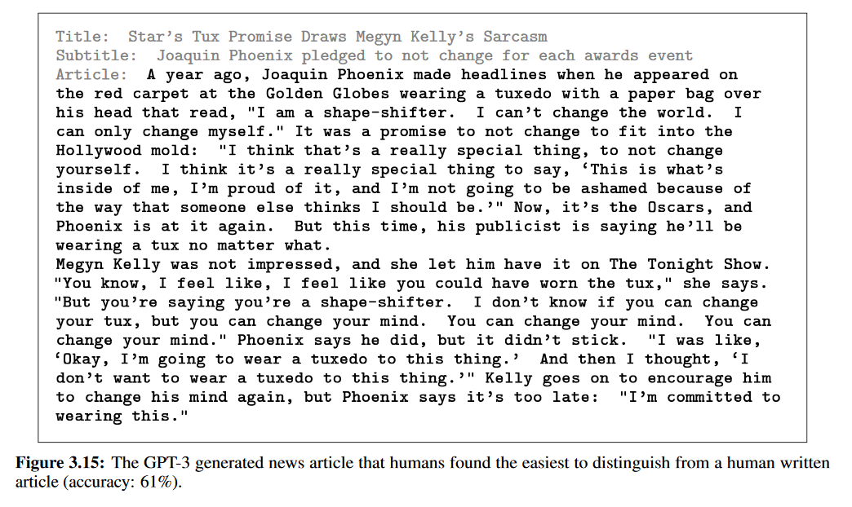

Slide 39
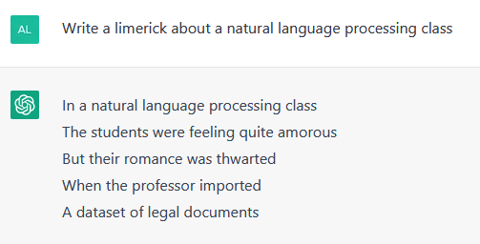
ChatGPT
Version of GPT3 optimised for dialogue through manual labelling
https://openai.com/blog/chatgpt/

Slide 40
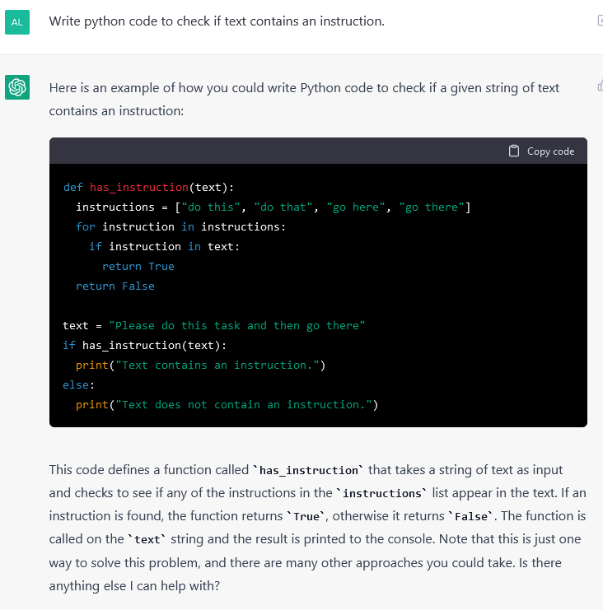

Slide 41
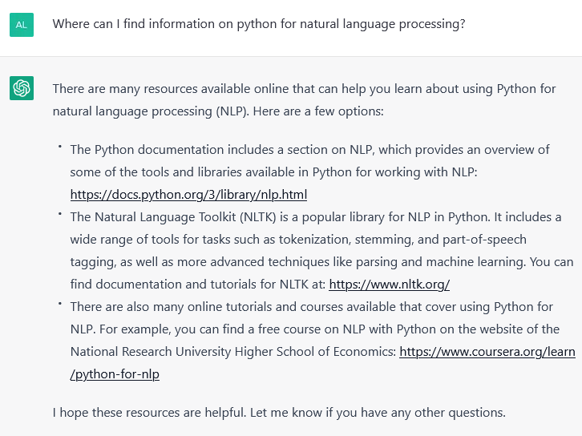
False Links

Slide 42
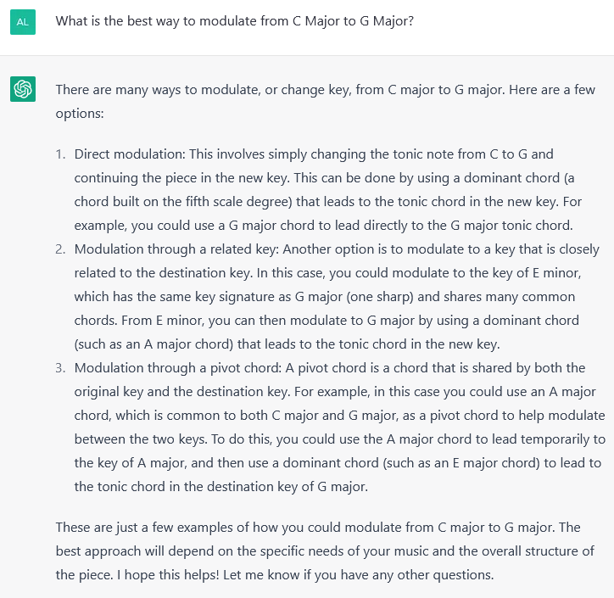
Hallucination

Slide 43
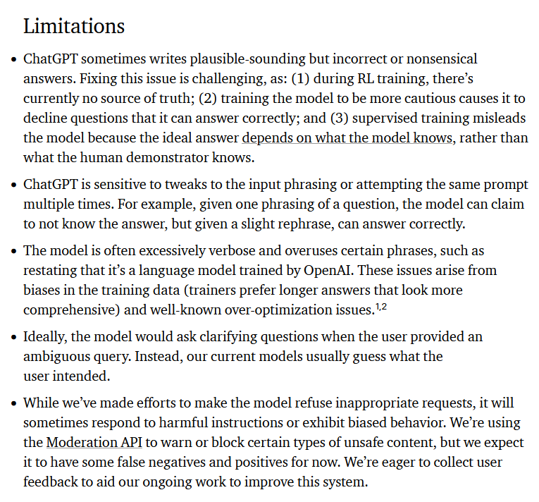
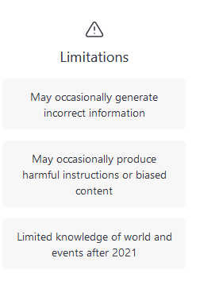
OpenAI list of limitations

Slide 44
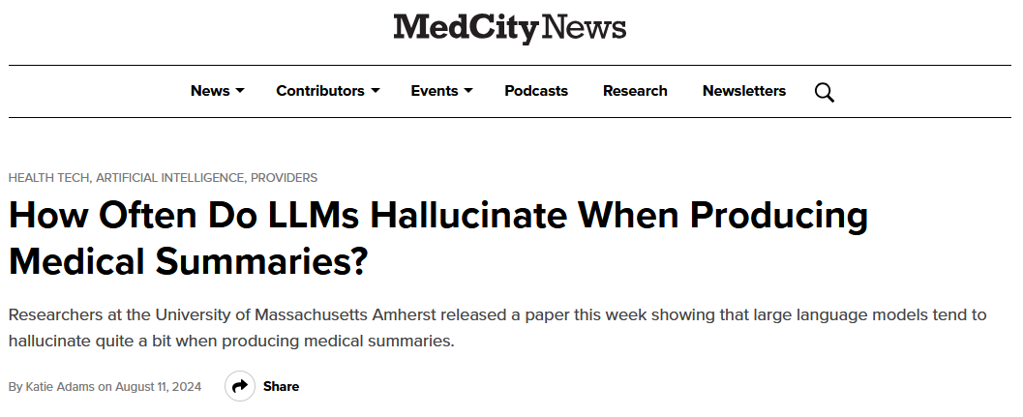
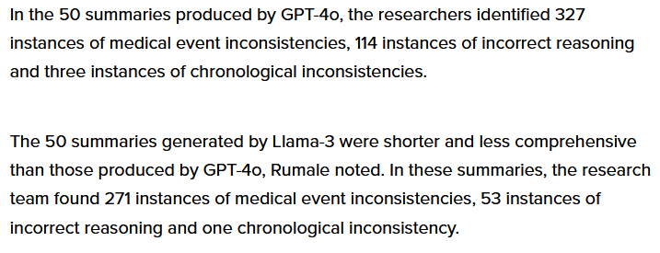
https://medcitynews.com/2024/08/ai-healthcare-llm/
https://openreview.net/pdf?id=6eMIzKFOpJ

Slide 45

Training Data Bias…
https://twitter.com/i/status/1291165311329341440

Slide 46
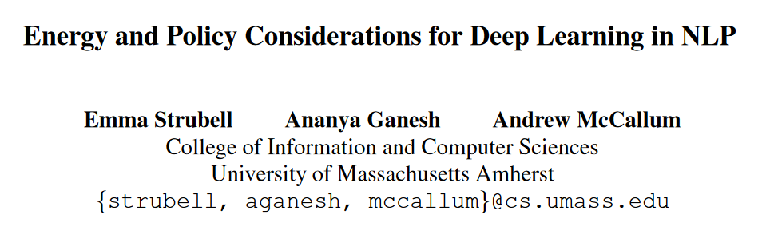
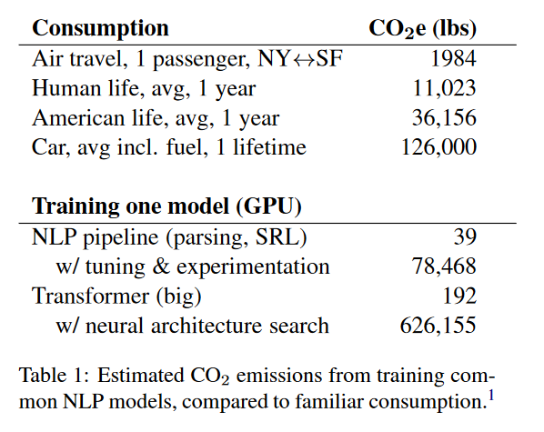
NLP and Climate Change
June 2019
https://arxiv.org/abs/1906.02243
Notes:
SRL – Semantic Role Labelling

Slide 47
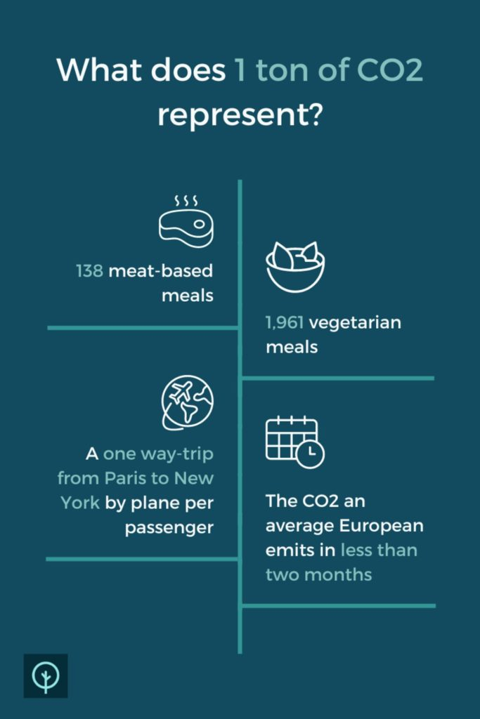
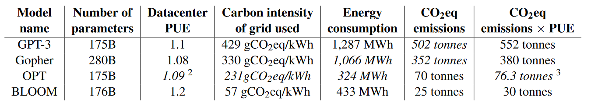
NLP and climate change
CO₂ equivalent emissions for model training
https://www.jmlr.org/papers/volume24/23-0069/23-0069.pdf
https://www.tapio.eco/blog/what-represents-one-ton-co2-emissions/
Notes:
The standardized measure that is often used for this is carbon dioxide equivalents (CO2eq), which are calculated based on comparing the global-warming potential (GWP) of different greenhouse gasses to that of carbon dioxide (CO2).

Slide 48
Summary
Neural approaches are big in NLP at the moment
Beware of bias
NLP can be bad for the climate

